Slide 1


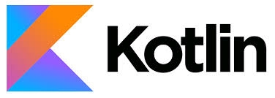
Topics
· Kotlin origin
· Why kotlin?
· Java vs Kotlin
· What can kotlin do for me?
· Kotlin support architecture
2020/06/01
By,
Pawan
Sr Software Engineer
VCS APP’s Team
India SW Lab

Slide 2
Kotlin origin
Kotlin is a cross-platform, statically typed, general-purpose programming language with type inference.
In July 2011, JetBrains unveiled Project Kotlin, a new language for the JVM, which had been under development for a year
The name comes from Kotlin Island
Kotlin v1.0 was released on 15 February 2016
At Google I/O 2017, Google announced first-class support for Kotlin on Android.
Kotlin v1.2 was released on 28 November 2017.Sharing code between JVM and JavaScript platforms feature was newly added to this release
Kotlin v1.3 was released on 29 October 2018, bringing coroutines for asynchronous programming.
On 7 May 2019, Google announced that the Kotlin programming language is now its preferred language for Android app developers.

Slide 3
Why kotlin?
Paradigm | Multi – Paradigm
Designed & Developed | Jetbrains
Typing discipline | Inferred, static, Strong
Platform | JVM, JavaScript
OS | Cross- platform
License | Apache License 2.0
FileName | .kt
Concurrent programming
Actor programming
Constraint programming
Dataflow programming
Declarative programming
Distributed programming
Functional programming
Generic programming
Imperative programming
Logic programming
Metaprogramming
Template metaprogramming
Reflective programming
Object-oriented programming
Class-based
Prototype-based
Pipeline programming
Rule-based programming
Visual programming
1) Easy setup
2) Interoperable with java
3) Boiler Plate - lots of lines of coding
4) Synthetic Extensions
5) Supports Multiple Languages
6) Null pointer exception (? & !!)
7) No semicolon's
8) Many standard Libraries
9) Lambda expressions
10) New Learnings

Slide 4
Million doller problem
3 ways of making program NULL safe
NULL Safety Operator
‘lateinit’ keyword
‘Lazy’ initialization
?.
Safe Call Operator
!!
Not Null Assertion
?:
Elvis
?.let {…}
Safe Call with let

Slide 5










Good for…
IDE’s
Mobile – Cross Platform
IntelliJ IDEA
Native
Data Science
Android Studio
Server – Side
Eclipse
Web development
Standalone Compiler
Android

Slide 6

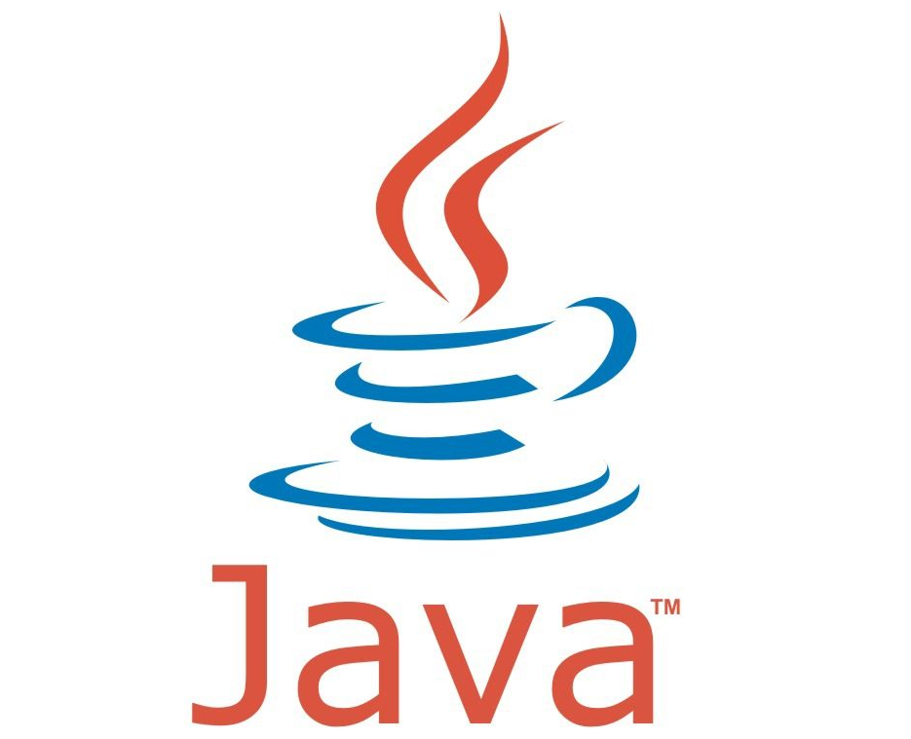
vs

Slide 7
What can kotlin do to me?
Can build applications for Phone and Tablets, Wear OS, TV, Android Auto and Android things
Kotlin for Cars :- Build apps for android automative OS
Media apps
Connectivity apps (Bluetooth and wifi)
Navigation apps
Messaging apps
Camera apps
Kotlin for TV :- Build apps for big screen
Great search UI
Provide content surgestions
Android KTX :- The set of Kotlin extensions that are included with Android Jetpack and other Android libraries.To do so, these extensions leverage several Kotlin language features, including the following
Extension functions
Extension properties
Lambdas
Named parameters
Parameter default values
Coroutines

Slide 8
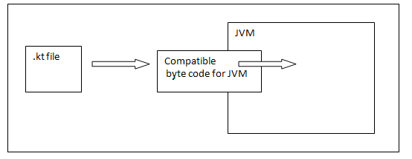
Kotlin Architecture
Kotlin has its own architecture to allocate memory and produce a quality output to the end user.
Kotlin compiler creates a byte code and that byte code can run on the JVM, which is exactly equal to the byte code generated by the Java .class file. Whenever two byte coded file runs on the JVM, they can communicate with each other and this is how an interoperable feature is established in Kotlin for Java.
Kotlin Architecture supports :- Data binding, LifeCycles, Live Data, Navigation, Paging, Room, ViewModel, WorkManager, CameraX, Media Playback, Notifications, Permissions, Preferences, Sharing, Animations and Transitions , ViewPager2, WebView

Slide 9
Kotlin Clean Architecture
This is an Android Clean Architecture base project using 100% Kotlin including Unit tests!
Benefit
Makes your new project clean
Isolates UI, business logic and data sources' responsibilities
Testable
Avoids multi-threading problems
Presentation
Domain
Data
Subscribe
Subscribe
View
(Activity or Fragment)
Use Case
(Business Logic)
Repository
Presenter
Remote API
Emit
Use Case
(Business Logic)
Emit
Observer
Local
Database

Slide 10
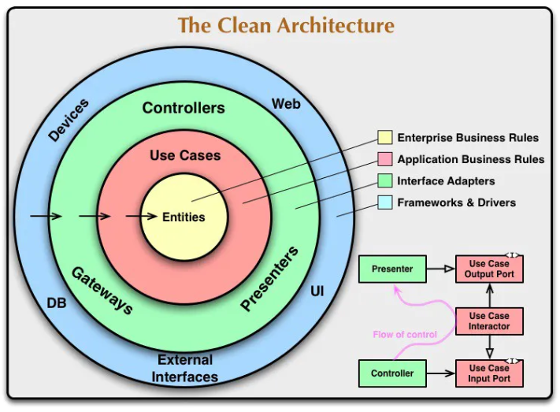
MVVM Architecture for kotlin

Slide 11
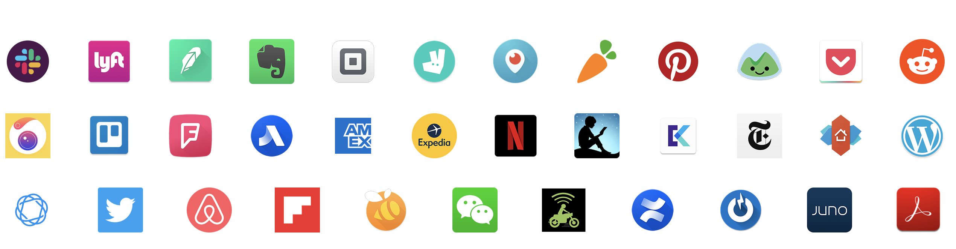
Kotlin Apps
Kotlin Open Source
Kotlin Reference
https://github.com/JetBrains/kotlin
https://kotlinlang.org/docs/reference/
Kotlin PlayGround
Kotlin CodeLabs
https://play.kotlinlang.org/
https://codelabs.developers.google.com/codelabs/java-to-kotlin/#0

Slide 12

Thank you

